Slide 1

Analysis of Biosignal Data AI4PH

Slide 2
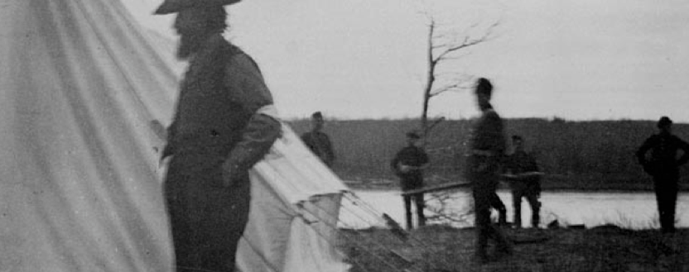
I acknowledge our shared connection to the land and recognize that Indigenous and Métis peoples on Treaty 6 Territory and all Indigenous peoples have been and continue to be stewards for social justice, equity, and land-based education. In the spirit of reconciliation may we all strive to learn and support the work of Indigenous communities as allies and return their land.

Slide 3
Ground Rules
Be proactive
Listen Actively
Speak from experience and relate this to published research
Be respectful
The goal is to learn
We will all fail to follow the ground rules at some point… that’s ok

Slide 4
Please
Ask questions
Tell me to slow down
Sorry for
Typos
Going too fast

Slide 5
There is no geek gene
“Competence at programming is not innate but is rather a learned skill that can be acquired and improved with practice.”
https://journals.plos.org/ploscompbiol/article?id=10.1371/journal.pcbi.1006023

Slide 6
Topics for today
Machine learning (30min)
Specific applications for biosignal data
Data break with Shelby (60min)
Equity in ML (20min)
Specific applications for biosignal data
R Tools and datasets (10min)

Slide 7
Machine Learning
Big Data
You can analyse “big data” with traditional approaches we have learned in this class like linear and logistic regression
But often to get more out of the data you need methods more suited to the data
Machine Learning
“A computer program is said to learn from experience E with respect to some class of tasks T and performance measure P, if its performance at tasks in T, as measured by P, improves with experience E’)”
https://doi.org/10.1136/jech-2017-209608

Slide 8
Types of Machine Learning
Supervised learning
Supervised learning is akin to the type of model-fitting that is standard in epidemiologic practice: The value of the outcome (i.e., the dependent variable), often called its “label” in machine learning, is known for each observation. Data with specified outcome values are called “labeled data.” Common supervised learning techniques include standard epidemiologic approaches such as linear and logistic regression, as well as many of the most popular machine learning algorithms (e.g., decision trees, support vector machines).
Unsupervised learning
The algorithm attempts to identify natural relationships and groupings within the data without reference to any outcome or the “right answer”. Unsupervised learning approaches share similarities in goals and structure with statistical approaches that attempt to identify unspecified subgroups with similar characteristics (e.g., “latent” variables or classes). Clustering algorithms, which group observations on the basis of similar data characteristics (e.g., both oranges and beach balls are round), are common unsupervised learning implementations.
https://towardsdatascience.com/all-machine-learning-models-explained-in-6-minutes-9fe30ff6776a

Slide 9
Types of Machine Learning
Semi-Supervised learning
Semisupervised learning fits models to both labeled and unlabeled data. Labeling data (outcomes) is often time-consuming and expensive, particularly for large data sets. Semisupervised learning supplements limited labeled data with an abundance of unlabeled data with the goal of improving model performance (studies show that unlabeled data can help build a better classifier, but appropriate model selection is critical)
https://towardsdatascience.com/all-machine-learning-models-explained-in-6-minutes-9fe30ff6776a

Slide 10
Types of Machine Learning
Classification
Identifying the category where an observation belongs, given known category labels. Logistic regression is an example of a classifier from statistics.
Regression
Predicting a continuous outcome. Linear regression is an example of a classifier from statistics.
https://towardsdatascience.com/all-machine-learning-models-explained-in-6-minutes-9fe30ff6776a

Slide 11
Models
Within supervised and unsupervised there are LOTS (hundreds) of different model types. These might have slightly different names or variations for specific tasks or to address different types of data.
There are many flavours (variations) of Random Forest and Artificial Neural Network type models.
It can be hard to keep up.
Pet Peeve!!!
Saying “using machine learning” is like saying “using statistics” it’s nearly completely uninformative in terms of describing what you actual did for your analysis.

Slide 12
Models
Within supervised and unsupervised there are LOTS (hundreds) of different model types. These might have slightly different names or variations for specific tasks or to address different types of data.
There are many flavours (variations) of Random Forest and Artificial Neural Network type models.
It can be hard to keep up.
Pet Peeve!!!
Saying “using machine learning” is like saying “using statistics” it’s nearly completely uninformative in terms of describing what you actual did for your analysis.

Slide 13
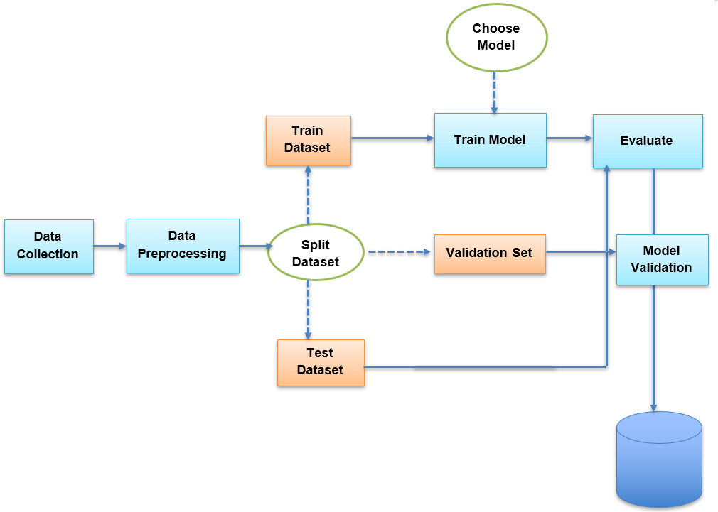
ML and biosignal data
Unique considerations
High frequency
How to understand time and extremely correlated data
Train/Testing
Data leakage
Feature extraction
Computational complexity
Equity (more later)

Slide 14
High frequency
Typical ML models and tutorials that you will see for ML do not consider high frequency data
Models do not automatically understand time or account for correlated nature of biosignal data. Need to know about specific models.
For accelerometer and other biosignal data types still lots of work on accounting for high frequency data.
Potential methods that can solve this problem
Recurrent Neural Networks (RNN) can keep track of arbitrary long-term dependencies but suffer from the ‘vanishing gradient problem’.
Long-Short Term Memory (LSTM) creates an additional module in a neural network that learns when to remember and when to forget pertinent information.
Transformer architecture. Much faster to train.
https://pubmed.ncbi.nlm.nih.gov/35884354/

Slide 15
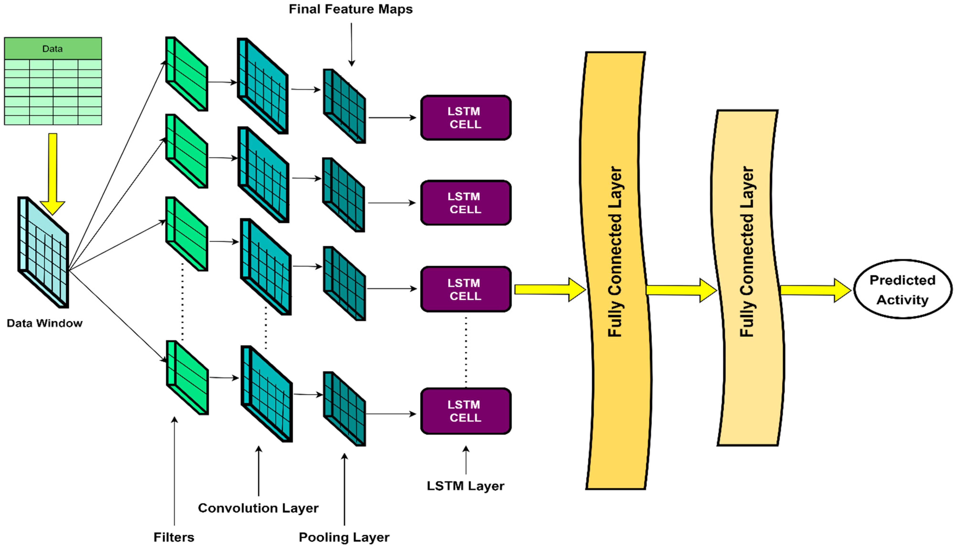
High frequency - Example
https://pubmed.ncbi.nlm.nih.gov/35884354/

Slide 16
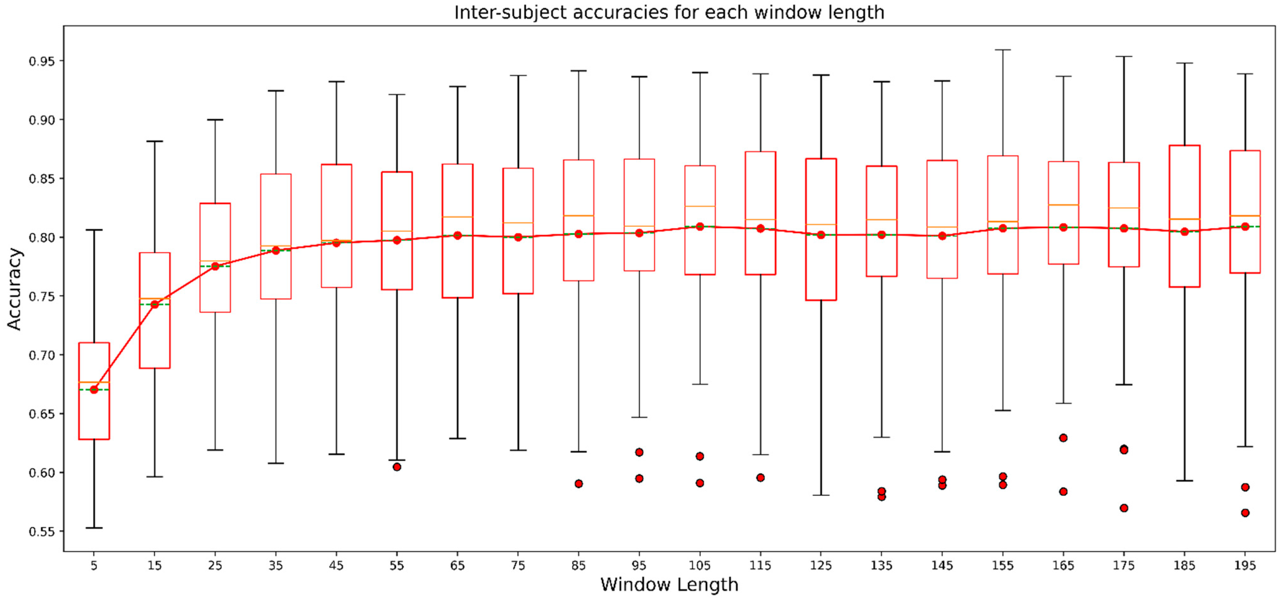
High frequency - Example
https://pubmed.ncbi.nlm.nih.gov/35884354/

Slide 17
Training/Testing
Most ML tutorials will very basic training and testing
70/30 split of the data
This does not work with biosignal data!
Data leakage
Use of information in the model training process which would not be expected to be available for prediction, causing overestimation of model quality.
Premature featurization: Leaking from premature featurization before testing
Time leakage: Splitting a time-series dataset randomly instead of newer data in test set.
Group leakage: Not including a grouping split column multiple contributions of data from same participant.

Slide 18
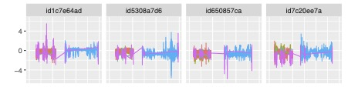
Training/Testing
Data leakage is a widespread failure mode in machine-learning (ML)-based science, having affected at least 294 academic publications across 17 disciplines, and causing a potential reproducibility crisis (https://doi.org/10.1016%2Fj.patter.2023.100804)
Current solves data leakage for biosignal data.
Leave on participant out cross validation
Keep the time series together.
k-fold cross validation can work but need to fold by participants.
Can group by different participant characteristics for equity analysis
Active research area.

Slide 19
Feature Engineering/Extraction
You worked on features for the assignment. Big challenge when you only start with 3 columns.
Some approaches
Use existing published features and more traditional models
Use unsupervised learning to develop features and more traditional models
CNN + neural net approaches create their own features

Slide 20
Feature Extraction
You worked on features for the assignment. Big challenge when you only start with 3 columns.
Fewer features that represent the data is much efficient than many features that don’t represent the data
Strong implications for model compute times
Some approaches
Use existing published features and more traditional models
Use unsupervised / self-supervised learning to develop features and more traditional models
CNN + neural net approaches create their own features

Slide 21
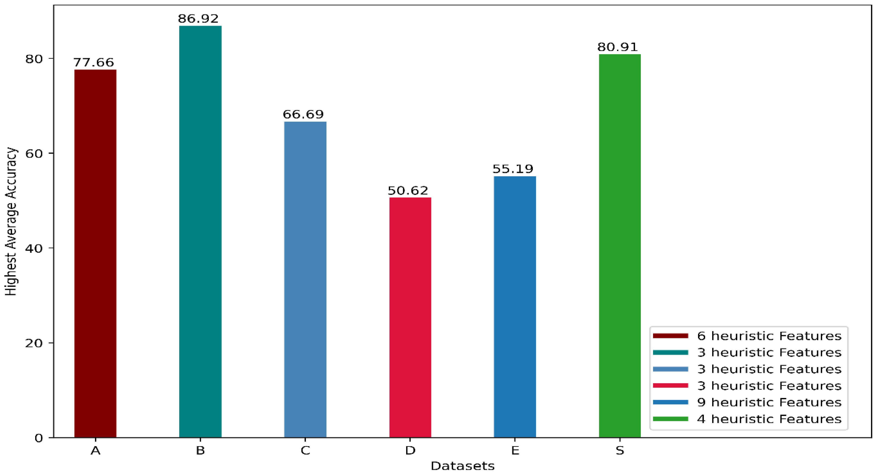
Feature Extraction
https://pubmed.ncbi.nlm.nih.gov/35884354/

Slide 22

Computational Complexity
Biosignal data methods produce large amounts of data
Much more than you are probably used to with health admin type data
Running this on your local computer is probably not feasible unless you have a very new machine.
Need to rely on high performance computing
Can’t say enough good things about Digital Research Alliance of Canada
For Canadian academics
5TB of active storage + 20TB backup storage
Free compute!
Amazing help and support

Slide 23
Equity
Equity is a critical concept in machine learning
Often characterised by notions of fairness (in different way).
“Equity” means justice: and justice is often a contentious issue.
Health equity
“Health equity means that everyone has a fair and just opportunity to be as healthy as possible…. For the purposes of measurement, health equity means reducing and ultimately eliminating disparities in health and its determinants that adversely affect excluded or marginalized groups.”
https://doi.org/10.1016/j.jnma.2022.08.004

Slide 24
Machine Learning Fairness
Equal patient outcome
Assurance that protected groups have equal benefit in terms of patient outcomes from the deployment of machine-learning models.
Weak form: ensuring that both equity deserving groups benefit similarly from a model (equal benefit).
Stronger form: both groups benefit and any outcome disparity is lessened (equalized outcomes).
https://doi.org/10.7326/M18-1990

Slide 25
Machine Learning Fairness
Equal performance
Assurance that a model is equally accurate for patients in the equity and non equity deserving groups. If a model systematically makes errors disproportionately for patients in the protected group, it is likely to lead to unequal outcomes. Equal performance has 3 commonly discussed types.
Equal sensitivity (aka. equal opportunity)
Equal sensitivity and specificity (aka. equalized odds)
Equal positive predictive value (aka. predictive parity)
These metrics be calculated, but techniques exist to force models to have one of these properties (see reference).
https://doi.org/10.7326/M18-1990

Slide 26
Machine Learning Fairness
Equal allocation
Equal allocation (aka. demographic parity), ensures that the resources are proportionately allocated to patients in the equity deserving group. Because the comorbidity distribution may differ across groups, the desired allocation might first be adjusted for relevant variables.
Distinct from equal performance, because allocation is determined by the rate of positive predictions (such as predictions above a threshold) without regard to their accuracy.
https://doi.org/10.7326/M18-1990

Slide 27
Machine Learning Fairness
Trade offs
Various types of fairness are sometimes incompatible
A model may be fair with respect to equal positive and negative predictive value but unfair with respect to equalized odds (or vice versa)
Impossible for any model to satisfy both.
Impossibility also holds for equalized odds and equal allocation, and for equal allocation and equal positive and negative predictive value.
Equity work is ultimately about values. You will need to make choices based on those values… and they may still be difficult choices.
https://doi.org/10.7326/M18-1990

Slide 28
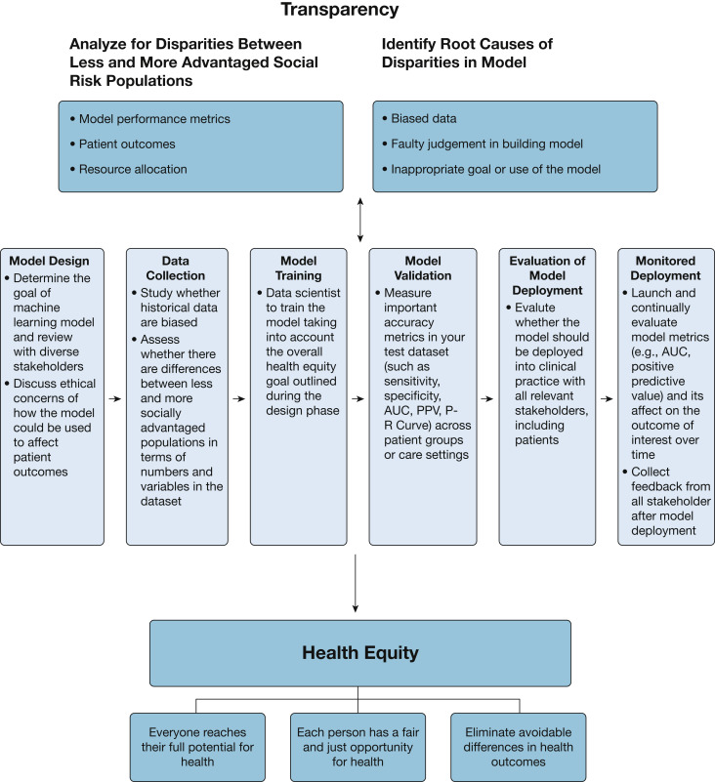
Machine Learning Fairness
https://doi.org/10.1016/j.chest.2022.02.001

Slide 29
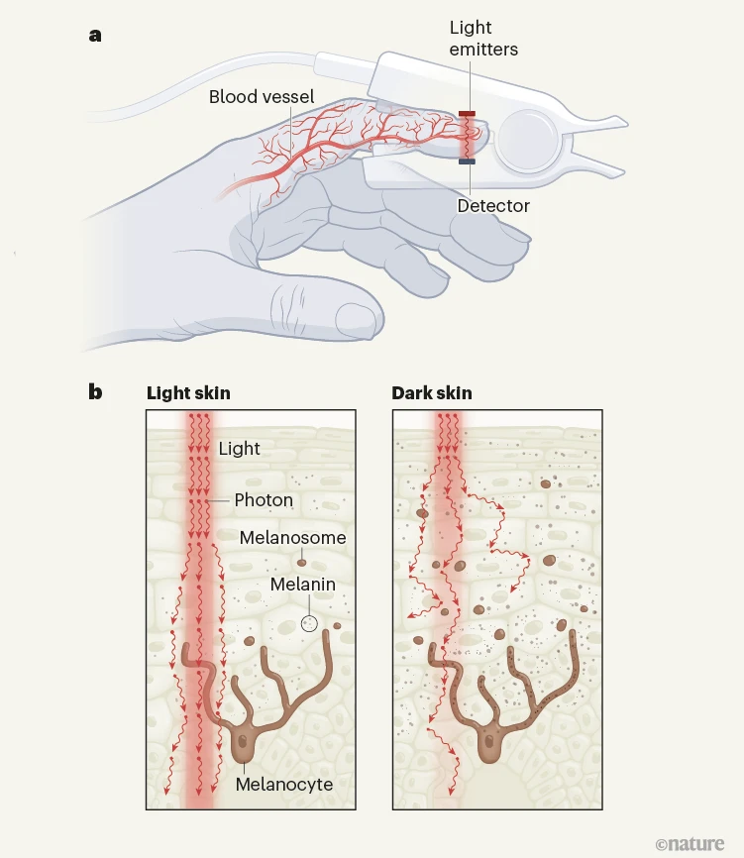
Machine Learning Fairness - Examples
Skin colour affects the accuracy of medical oxygen sensors
Enrolment guidance from the FDA for testing oximeter accuracy suggests that studies should involve a minimum of ten people, at least two of whom should be “darkly pigmented” (https://www.nature.com/articles/d41586-022-03161-1 ).

Slide 30
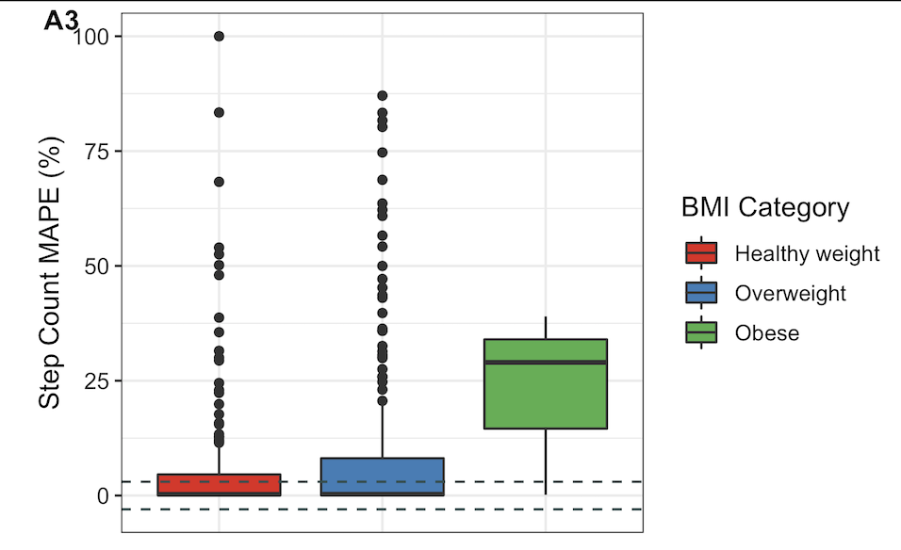
Machine Learning Fairness - Examples
Step count and body weight
In studies with participants experiencing overweight or obesity compared to normal weight participants using commercial wearable devices, step count was overestimated, while heart rate and energy expenditure were underestimated.
https://doi.org/10.1123/jpah.2022-0160

Slide 31
Tools
https://physionet.org/
Tools, data, code, all the things!
R packages
biosignalEMG (https://cran.r-project.org/web/packages/biosignalEMG/index.html)
Trackign data Task View
https://cran.r-project.org/web/views/Tracking.html
Biosignal Tools
https://github.com/dongzhenye/biosignal-tools
UC Irvine ML repository
https://archive.ics.uci.edu/

Slide 32
Further reading
Lee, Y.J., Park, C., Kim, H. et al. Artificial intelligence on biomedical signals: technologies, applications, and future directions. Med-X 2, 25 (2024). https://doi.org/10.1007/s44258-024-00043-1
Rajkomar A, Hardt M, Howell MD, Corrado G, Chin MH. Ensuring Fairness in Machine Learning to Advance Health Equity. Ann Intern Med. 2018 Dec 18;169(12):866-872. doi: https://doi.org/10.7326/M18-1990 . à

